Slide 1
BLOCKCHAIN
GENESIS TO DIGITAL MONKEYS
A practical look at the technology
Blockchain introduction course for
Scott York

Slide 2
Ask questions
You will gain more out of this course by asking as many questions as you can while we go through the topics will help your understanding.
Remember no question is too silly if you do not understand something, trust me you will not be the only one wanting to know the answer.

Slide 3

Course outline
History
A brief history of the technology
Genesis
Get an understanding of the terminology
Technology
Talk Cryptocurrency, NFT and using decentralised networks
Lets take a look
Explore the technology that is being used today
Practical
Write & deploy a smart contract, create transactions
The good, the bad and the ugly
Look at many of the positives and negatives so you can use the technology with confidence and change the world

Slide 4
What will I achieve
A basic understanding of the technology
Get to grips with some of the main terminology
Explore some blockchain web-sites
Create a smart contract, deploy and run it

Slide 5
So before we start…

Slide 6
What is blockchain?

Slide 7





The three things you need to know
By student participation
What it’s not
It’s not a solution to everything, and everything that is currently using blockchain; blockchain may not be the best thing to use.
Lets take 3 people
What does it solve
It proves that something is what it says it is, based on a series of facts about what the something is and who it should be used….. WHAT!!!!!!
Lets take every one
Where do you start
It all starts with a problem that requires something being exchanged, shared or given to another person(s) or entity
Lets take 1 person
£$@%!@

Slide 8
History

Slide 9
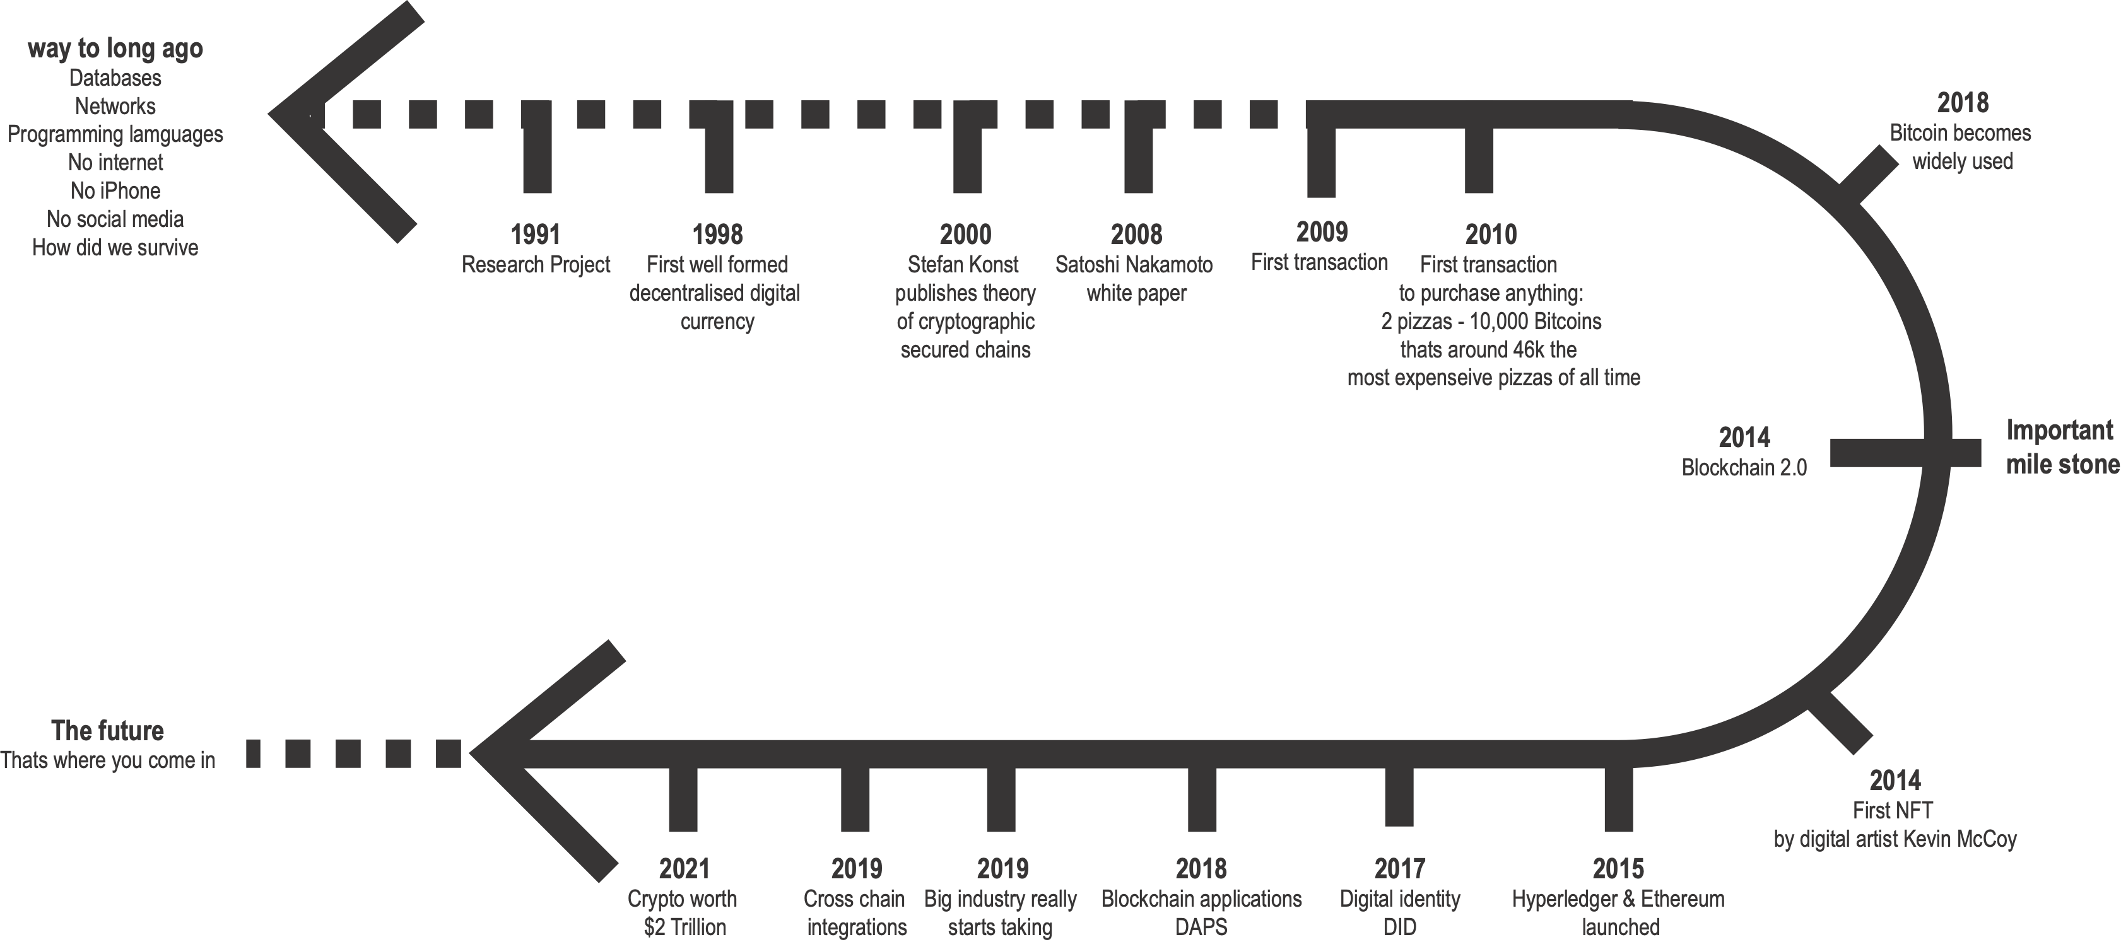
Timeline
A very brief walk through some of the key events in the history of blockchain

Slide 10

What has history done for blockchain
Most of the history is still to be written
Why is it important to know some of the history of the technology
Understand it is not just cryptocurrencies
What blockchain being used for now and into the future
Who’s using blockchain technologies and why
There are many crossroads into other technologies from the world of blockchain how can you take advantage of them

Slide 11
Crossroads
Where your understanding of the technology could lead
Even the basic understanding of the technology could lead you into a world of different opportunities
Where is blockchain being used?
Just a few examples from the thousands that are currently being developed
Financial services
Crypto trading and contract management of assets and funds
Healthcare
Doctor credentials and research and development of vaccinations
Music industry
Copywriting of music and creation of NFTs to promote record sales
Online stores
Buying everything from pizzas to a new car can be done with crypto
Education
Get you student transcripts as a verifiable credential valid world wide
National currency
El Salvador has adopted Bitcoin as it’s national currency

Slide 12
Genesis

Slide 13
Genesis
Where it all begins
A Genesis Block is the name given to the first block of your network, such as Bitcoin, when mining begins for the first time. A blockchain consists of a series of so-called blocks that are used to store information related to transactions that occur on a blockchain network. Each of the blocks contains a unique header, and each such block is identified by its block header hash individually…
Wow that sounds like a lot of nonsense….
Importance of understanding the terminology
https://101blockchains.com/blockchain-for-beginners/
https://consensys.net/knowledge-base/a-blockchain-glossary-for-beginners/

Slide 14
What is blockchain?
Lets start at the beginning
Blockchain is a distributed ledger technology which improves on the centralised-based solutions in different ways. It consists of peers connected in a distributed network where each peer has a copy of the ledger. To validate the transactions between those peers, the network utilises a consensus algorithm.
Nope…
Again we are looking at a lot of technical jargon,
so let's break down the moving parts and understand the jargon.
There are many very technical elements to blockchain technology, they can put you off from diving in, do no let it
A good understanding of the key elements is very important
And understanding the follow of information

Slide 15
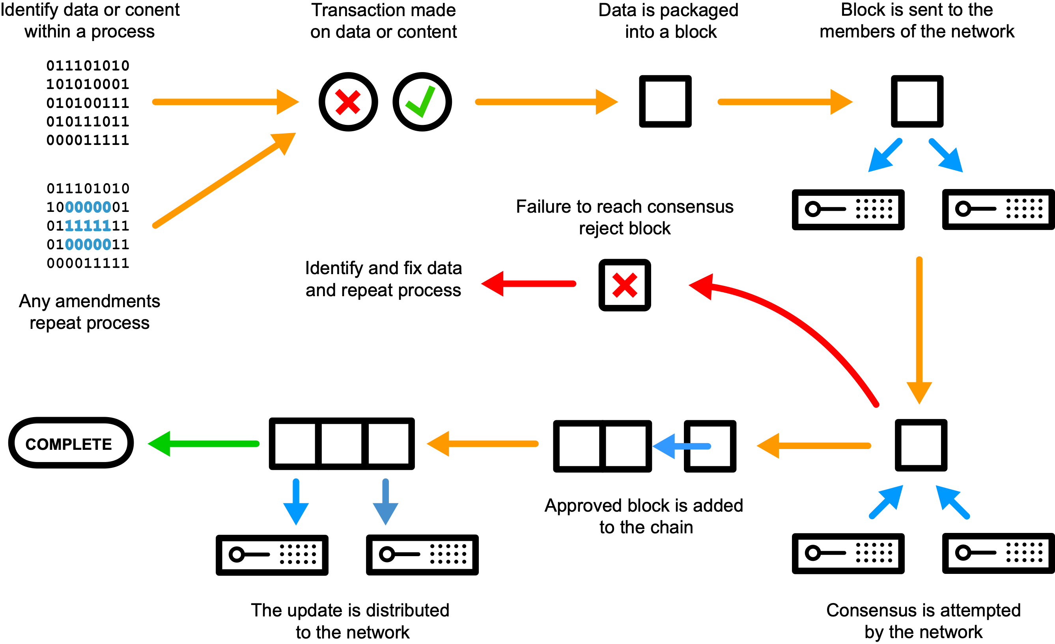
Blockchain from 1000 meters up

Slide 16
The top 5
Key elements to the blockchain network
Like most technology those that know it speak about it with the expectation that everyone else knows about it. While some of the terms are universal their use when applied to blockchain can have a different.
Ledger
The ledger is a database that stores all the information about a give transaction. Based on the type of blockchain network the data can vary.
Transactions
These are the interactions between individuals or entities to exchange information, this could be transfer of crypto, exchange of a document or any digital information
Smart Contract
These are the rules that govern that transactions between a defined number of parties or to validate that he electronic information conforms to the pre-approved criteria. You do not need smart contract to simply write data but with them they define the legitimacy of the information in the database
Network
Is the collection of computers called nodes, which all talk to one another a peer to peer configuration. This makes sure the information is the same in every location. Software is used to synchronise these computers and validate the transfer of is information and validity of the stored data
Consensus
This is the mechanism each node uses to validate the information before it is committed to the database (ledger).
https://consensys.net/knowledge-base/a-blockchain-glossary-for-beginners/

Slide 17
The more you know the more you understand
Hash
hash is a function that meets the encrypted demands needed to solve for a blockchain computation. Hashes are of a fixed length since it makes it nearly impossible to guess the length of the hash if someone was trying to crack the blockchain.
Encryption
Blockchain encryption is the prevention of sensitive information from getting into the wrong hands and being misused or forged.
Blocks
Blocks are data structures within the blockchain database, where transaction data in a cryptocurrency blockchain are permanently recorded. A block records some or all of the most recent transactions not yet validated by the network. Once the data are validated, the block is closed.
Header
A block header is used to identify a particular block on an entire blockchain and is hashed repeatedly to create proof of work for mining rewards
Immutable
Immutable transactions make it impossible for any entity (for example, a government or corporation) to manipulate, replace, or falsify data stored on the network.
Algorithm
Is a process in computer science used to achieve agreement on a single data value among distributed processes or systems. Consensus algorithms are designed to achieve reliability in a network involving multiple unreliable nodes.
Metamask/Wallet
A blockchain wallet is a digital wallet that allows users to store and manage their Bitcoin, Ether, and other cryptocurrencies.
Nouce
Nonce is used by authentication protocols to ensure that old communications cannot be reprocessed. Hashing. Proof of work systems use nonce values to vary input to a cryptographic hash function. This helps fulfill arbitrary conditions and provide a desired difficulty.
Decentralized
In blockchain, decentralization refers to the transfer of control and decision-making from a centralised entity (individual, organisation, or group thereof) to a distributed network.
Consortium
Blockchain technology where instead of only a single organisation, multiple organizations govern the platform.

Slide 18
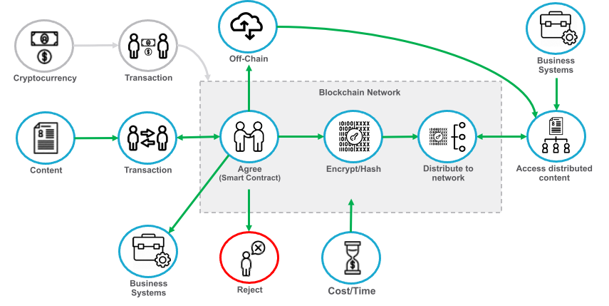
Where does blockchain fit in the process
Blockchain is the source of truth

Slide 19
Web 3
Yes they has been 3 of them…
Advances in web technologies have made blockchain viable, this new iteration of the technology is Web 3. It is home to all the features that allow use to create, manage and consume information from blockchain
Web 1.0
The first iteration of the web represents the web 1.0, which, according to Berners-Lee, is the “read-only web.” In other words, the early web allowed us to search for information and read it. There was very little in the way of user interaction or content generation.
Web 2.0
Web 2.0 also gave rise to web apps, self-publishing platforms like WordPress, as well as social media sites. 1. Examples of Web 2.0 sites include Wikipedia, Facebook, Twitter, and various blogs, which all have transformed the way the same information is shared and delivered.
Web 3.0
Web 3.0, also known as the third-generation internet, is the next evolution of the World Wide Web. It provides a data-driven Semantic Web employing a machine-based understanding of data with the objective of developing a more intelligent and connected web experience for users.

Slide 20
Development
You are a consumer of blockchain, not a developer of blockchain
Blockchain Software Developer: Blockchain software developers maintain a rather high-level interaction with the Blockchain. Their role is to use the algorithms developed by core Blockchain developers and incorporate them into their applications, developing decentralized applications that run on the Blockchain.

Slide 21
Questions so far?

Slide 22
Technology

Slide 23
What does blockchain need to exist
It’s more than you think!
There are many steps that go into building a blockchain solution we are really only concentrating on step 5 for this course
Step 1: Identify a Suitable Use-case.
Step 2: Identify the Most Suitable Consensus Mechanism.
Step 3: Identify the Most Suitable Platform.
Step 4: Designing the Nodes.
Step 5: Design the Blockchain Instance (Smart contracts, Inputs and Outputs, deployment).
Step 6: Building the APIs.
Step 7: Design the Admin and User Interface.

Slide 24
Do we agree on this?
Types of consensus
There are 3 main consensus algorithms, these agree on the correct state of a given piece of information, this is the key to how blockchain technology works
Proof of Work (POW)
Proof-of-Work is a consensus algorithm that validates the transaction verification of a miner.
Proof-of-Work is basically the miner ensuring the verifier that the mining process is valid and accurate.
Solving the algorithm from the miner is really hard, but checking the validity of the verification is very easy.
Advantages of POW are decentralization and the security it provides.
Drawbacks of POW are the cost and the centralisation in practical terms because of mining pools.
Proof of Stake (POS)
Proof-of-stake comes with a number of improvements to the proof-of-work system:
better energy efficiency – you don't need to use lots of energy mining blocks
lower barriers to entry, reduced hardware requirements – you don't need elite hardware to stand a chance of creating new blocks
stronger immunity to centralisation – proof-of-stake should lead to more nodes in the network
stronger support for shard chains – a key upgrade in scaling the Ethereum network
Practical Byzantine Fault Tolerance (PBFT)
PBFT consensus rounds are called views and are broken into 4 phases:
A client sends a request to the leader node to invoke a service operation.
The leading node broadcasts the request to the backup nodes.
The nodes execute the request, then send a reply to the client.
The client awaits f+1 replies from different nodes with the same result, where f represents the maximum number of potentially faulty nodes.

Slide 25
Not all networks are created equal!
With so many crypto currencies and blockchain providers where to you start
BigChainDB
Chain Core
Corda
Credits
Domus Tower Blockchain
Elements Blockchain Platform
Eris:db
Ethereum
HydraChain
Hyperledger Fabric
Hyperledger Iroha
Hyperledger Sawtooth
Multichain
Openchain
Quorum
Stellar
Symbiont Assembly
Ethereum
Ethereum is a decentralized, open-source blockchain with smart contract functionality. Ether is the native cryptocurrency of the platform. Among cryptocurrencies, Ether is second only to Bitcoin in market capitalisation.
Hyperledger Fabric
Hyperledger is a global enterprise blockchain project that offers the necessary framework, standards, guidelines, and tools to build open-source blockchains and related applications for use across various industries.
Ethereum is a public network. All the transactions are entirely transparent and anyone with access to the internet can view these transactions. Hyperledger is limited access or allowed blockchain network.
We will be using the Ethereum network for the practical part of this course

Slide 26
One size does not fit all
It all depends on what you need to do
Public
Public blockchains are designed to be fully accessible by everyone. No one individual or entity controls which transactions are recorded in the blockchain or the order in which they are processed.
Private
Participants need consent to join the networks transactions are private and are only available to ecosystem participants that have been given permission to join the network private blockchains are more centralised than public blockchains
Hybrid
The hybrid blockchains use a combination of the public and private blockchain principles. There are many scenarios, having permissions to write to the Blockchain, but anyone can read it. Or accessing content that is not practical to store on the main Blockchain and use our platform for off-chain content
Consortium
Federated blockchain or consortium blockchain is a blockchain technology where instead of only a single organisation, multiple organizations govern the platform. It's not a public platform rather a permissioned platform.
Lets talk practical…
You are a song writer and you have just written the best lyrics in the history of the world, you want to share them with everyone but because they are that good you want to con

Slide 27
Cryptocurrencies
The new paper money
Cryptocurrency is an encrypted data string that denotes a unit of currency. It is monitored and organised by a peer-to-peer network called a blockchain, which also serves as a secure ledger of transactions, e.g., buying, selling, and transferring.
Let’s take a look some of the most popular cryptocurrencies and what are the differences.

Slide 28
NFT - Non fungible tokens
The new digital banksy or are they just monkeys
Within those quirky artworks, there's a unique digital identifier that cannot be copied, substituted, or subdivided, that is recorded in a blockchain, and that is used to certify authenticity and ownership (as of a specific digital asset and specific rights relating to it)
Anyone can create digital artwork and produce a NFT and in todays market you can make a lot of money

Slide 29
Digital identities
Prove your identity without send physical verification
Any personal data that can be traced back to the real you constitutes your digital identity. For example, images you've shared on social media, posts you've written or commented on, your online bank account, search engine history, and yes, your Steam account if you're a gamer.
Digital identity goes beyond humans, lets take a car…..

Slide 30
How much
The cost of block chain is not cheap
When building you solutions the first thing you need to do before you look at writing a single line of code is how much it is going to cost to write to the blockchain.
Then who is going to pay for that transaction, this is on top of the service you maybe offering.
This is where you need to look at the platform, payment type and technology supporting your blockchain solution,

Slide 31
Networks
What do you need for a blockchin network
While the different types of network have very different methods of producing the records on the blockchain the basic concept for the network is exactly the same.
The decentralized ledger technology records any digital asset or transactions without involving any third party in the procedure. The key aspect on which a business functions is information, the faster and more accurate the information is the better it is, so only write the information that is critical to the process.
Lets talk through this diagram in
more detail…

Slide 32
Questions so far?

Slide 33
Let’s take a look

Slide 34
Blockchain in the world today

Slide 35
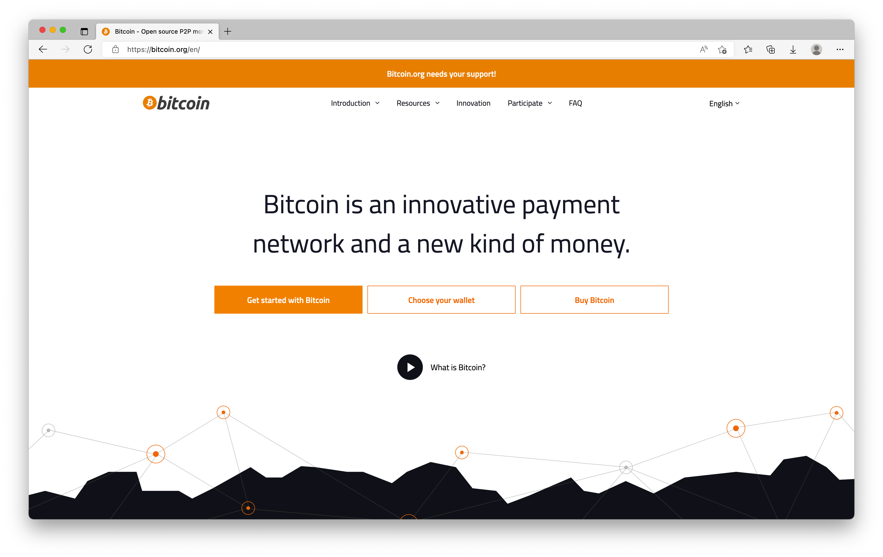
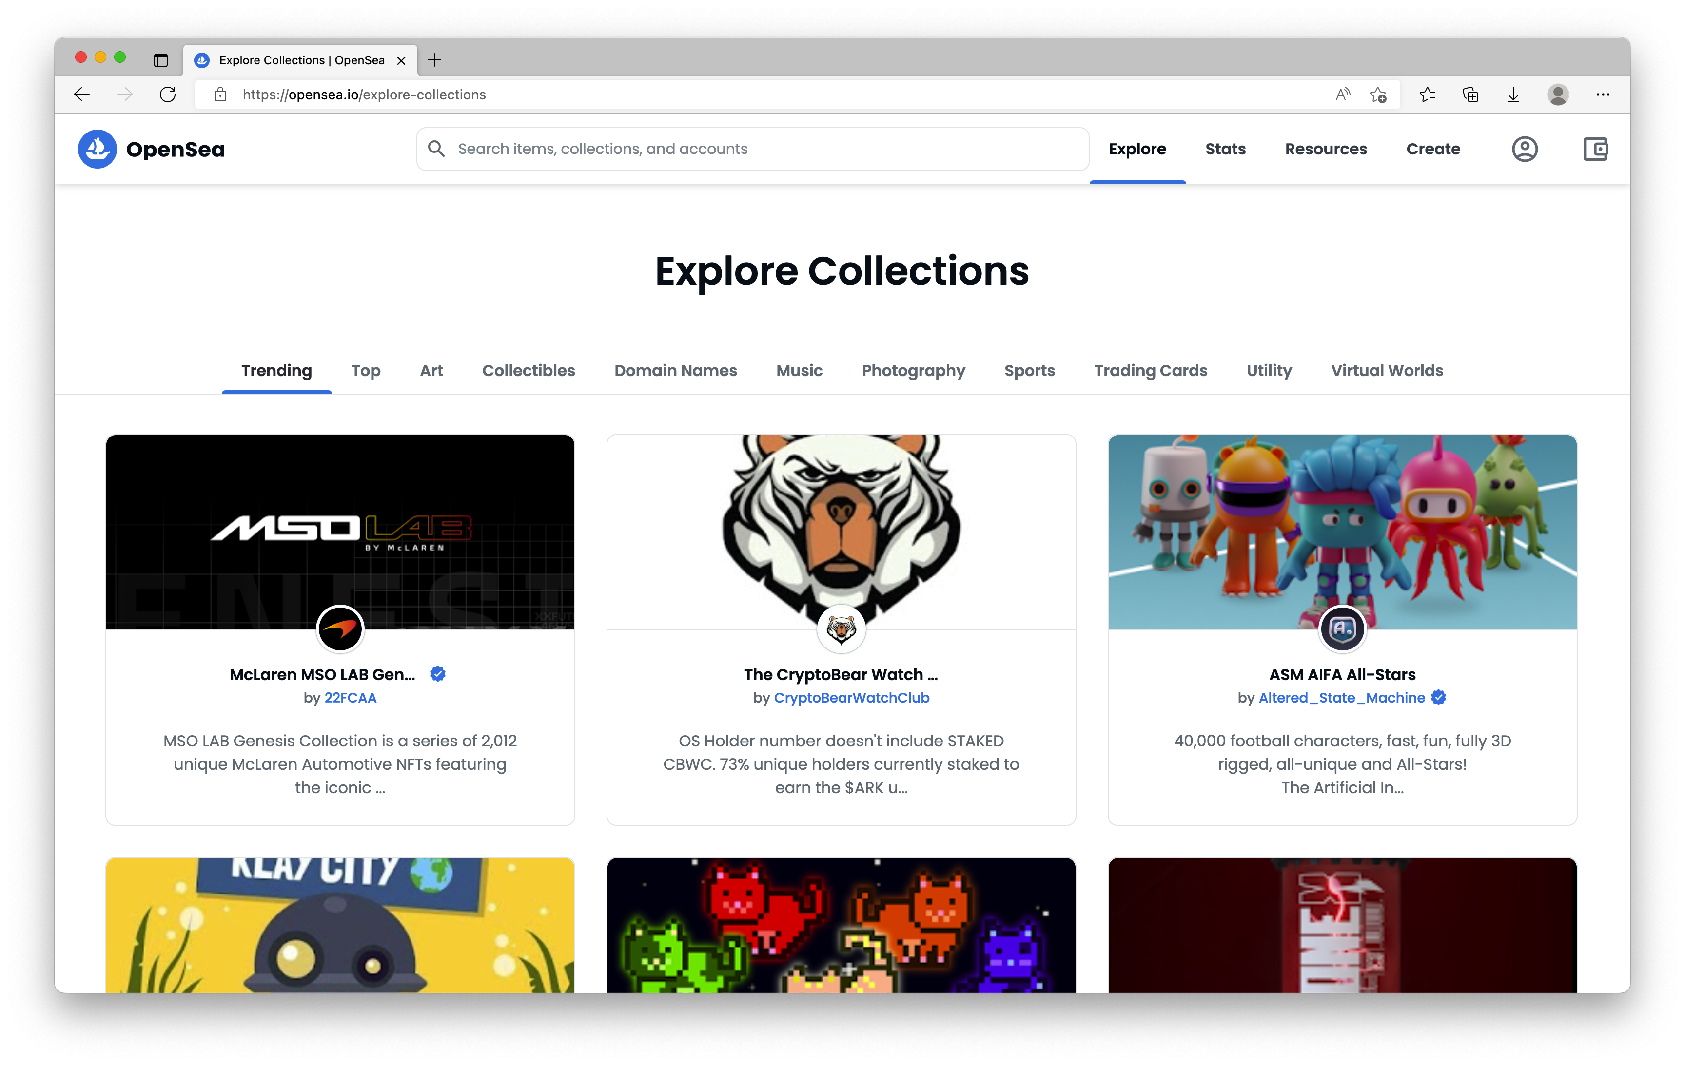
Explore some blockchain websites
Lets discuss the technology behind them
BitCoin
Explore cryptocurrency
Opensea
Explore NFTs
http://bitcoin.org/
https://opensea.io/

Slide 36
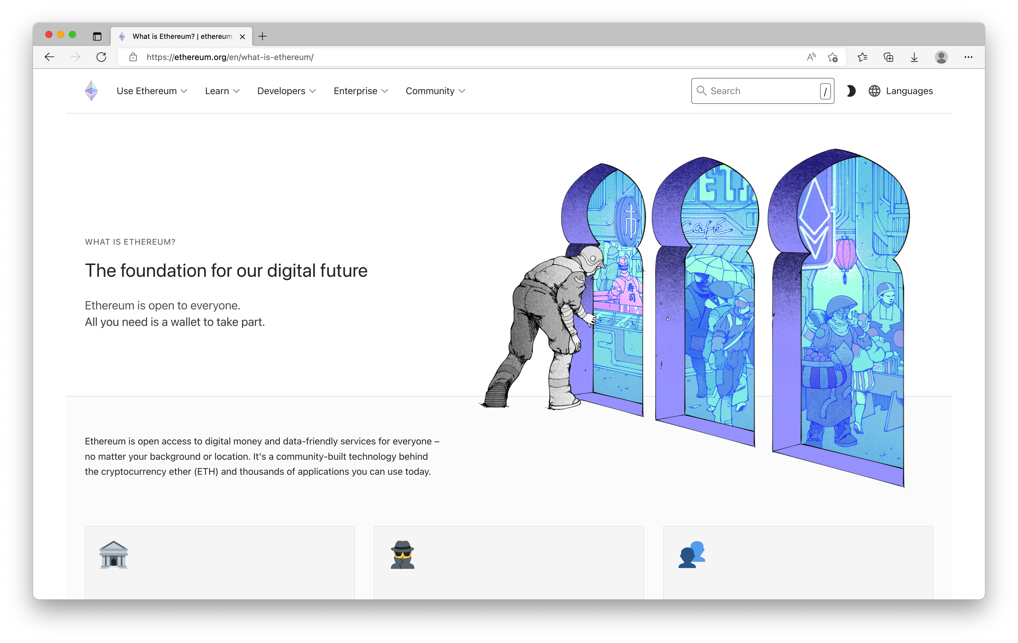
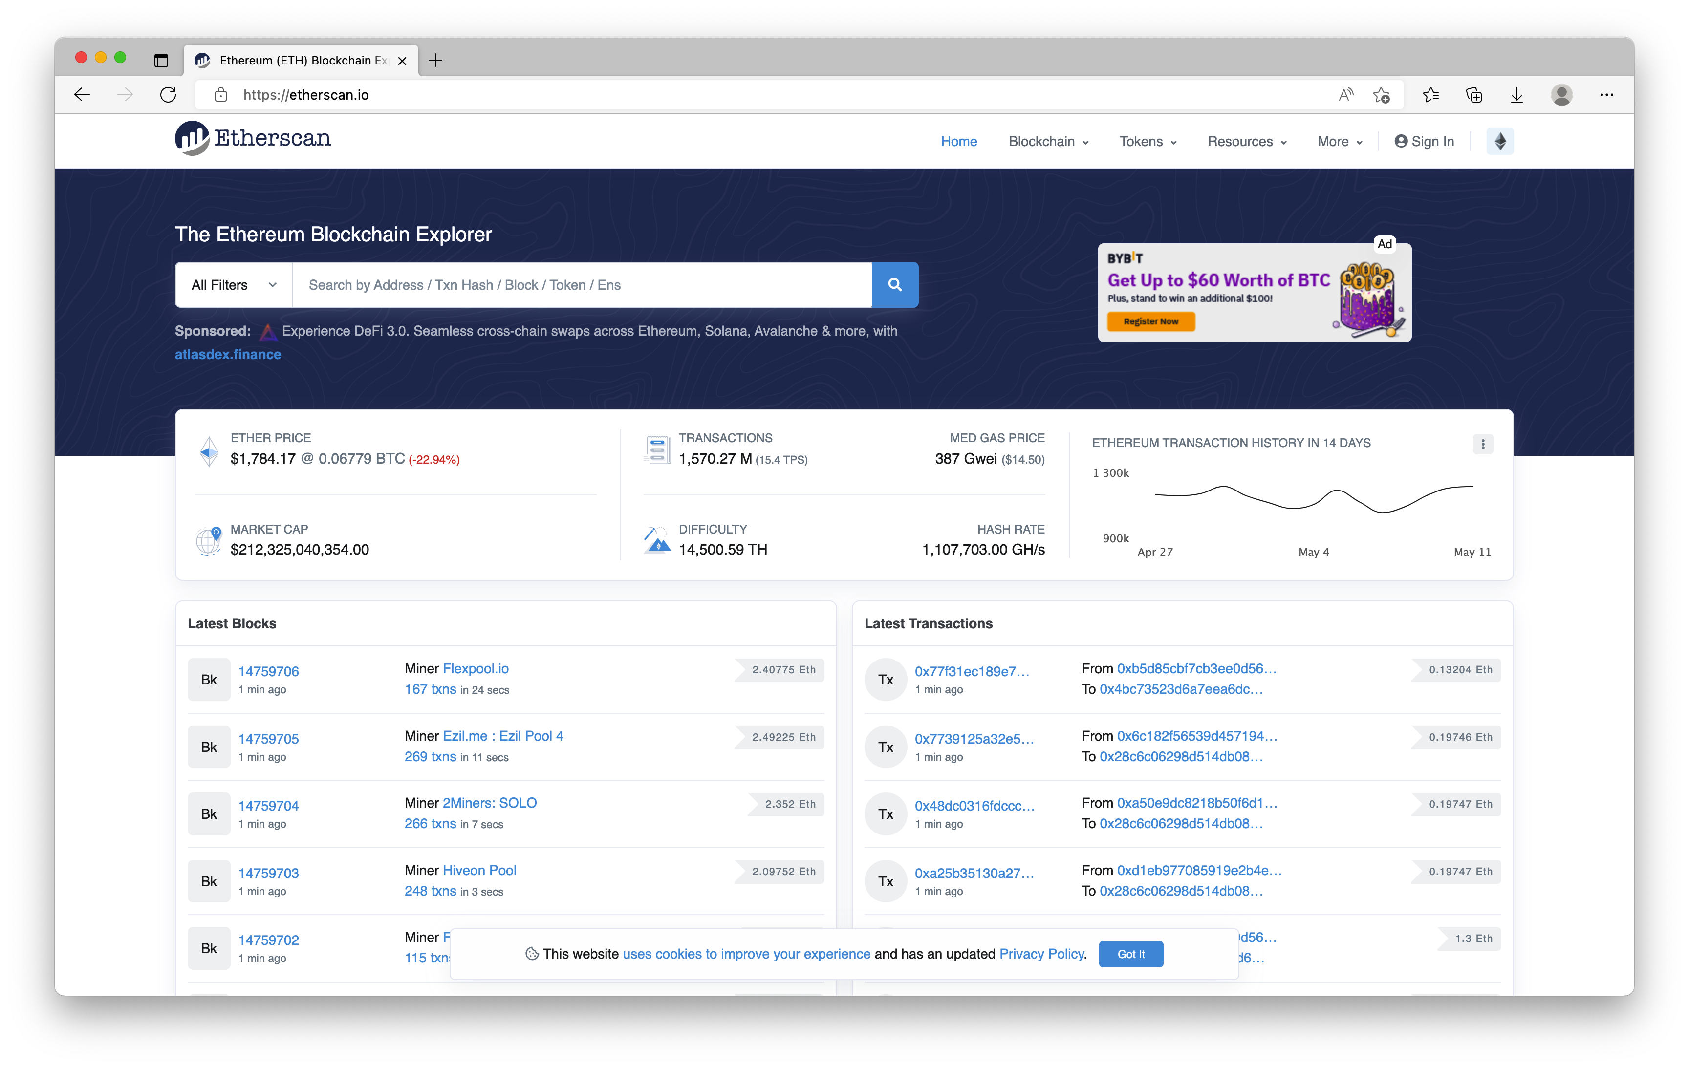
Explore more blockchain websites
Lets discuss the technology behind them
Ethereum
Explore blockchain technology
Etherscan
Explore transactions on the blockchain
https://etherscan.io/
https://ethereum.org/

Slide 37
Practical

Slide 38
Tools of the trade
Most of the history is still to be written
Your toolset will be dictated to some degree by the platform technology.
Everyone has preferences, but it is good to know other ways of delivering your solutions.
Basic walk through my development tools.
Mac, VS Code, Remix, Docker, Node, .Net, Javascript, HTML, Solidity

Slide 39
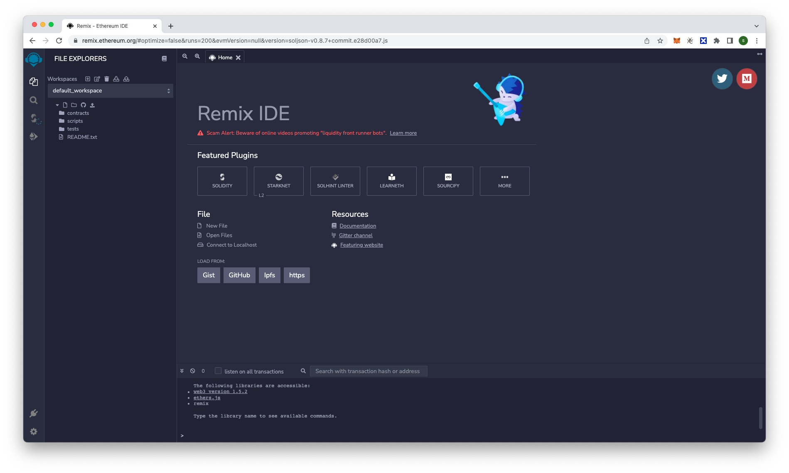
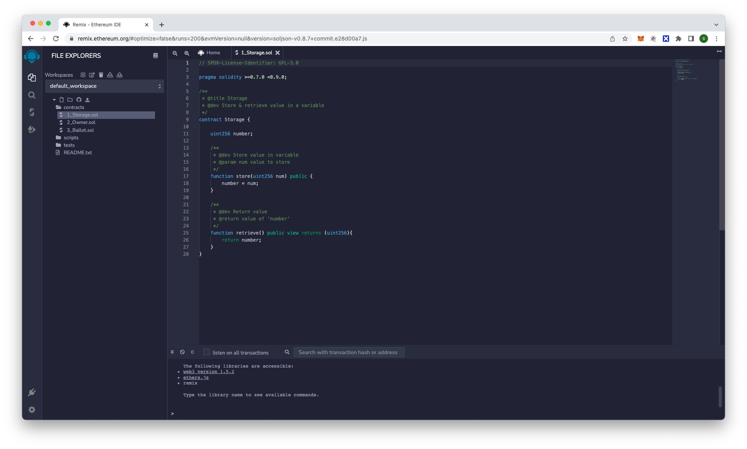
Remix
Ethereum web-based tool
https://remix.ethereum.org/
Web based integrated development environment
Using Solidity language
Build smart contracts
Deploy smart contracts
Test smart contracts
Caption
Caption

Slide 40
Solidity programming language
Simple to complicated fast
// SPDX-License-Identifier: GPL-3.0
pragma solidity >=0.7.0 <0.9.0;
/**
* @title Storage
* @dev Store & retrieve value in a variable
*/
contract Storage {
uint256 number;
/**
* @dev Store value in variable
* @param num value to store
*/
function store(uint256 num) public {
number = num;
}
/**
* @dev Return value
* @return value of 'number'
*/
function retrieve() public view returns (uint256){
return number;
}
}
What we need to do to keep things simple
Look at the syntax
Look at the process
How do we make changes
How do we test it works

Slide 41
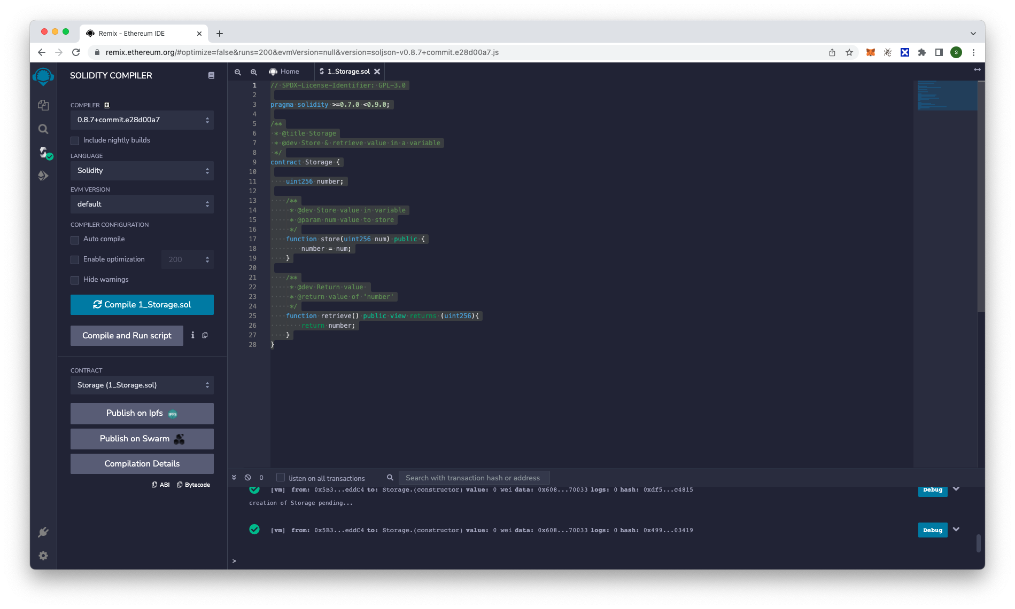
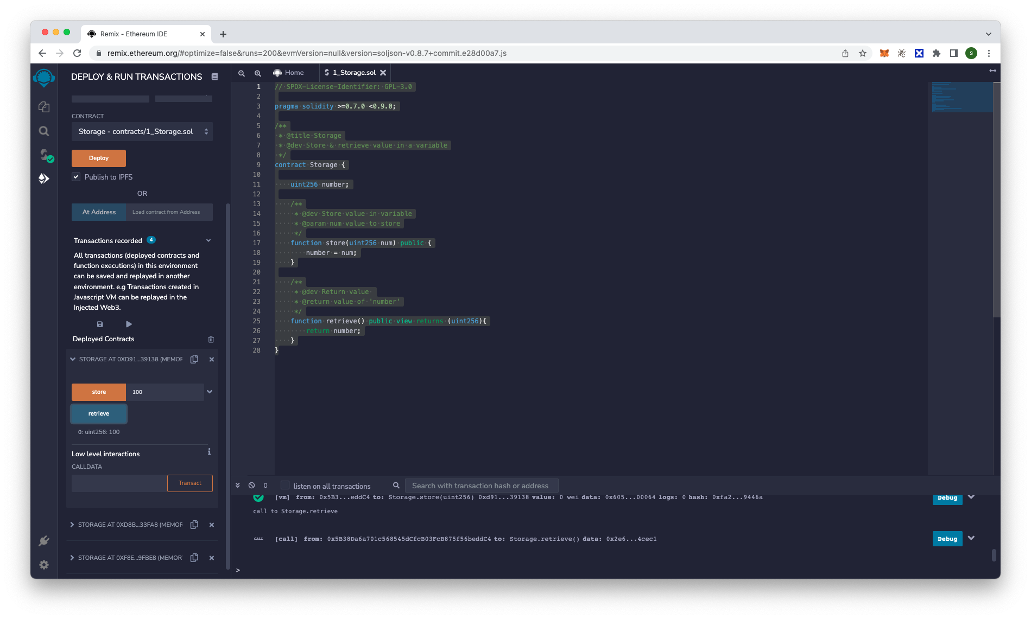
Compile & Publish
Remix makes this simple
What does the compiler do
Fixing issues
Deploying my contract
Running my contract
Testing the contract
Caption
Caption

Slide 42
Our grammy is in the post
Extending our smart contract
Enter song lyrics
Check the length of the string
Add the string to the variable
Retrieve the whole string
Retrieve a part of the string
Buy the lyrics
Add the name of the new owner
We will be making NO payments and all the code we will be producing will only ever exist within your test environment.
If you want to take this to the next level and produce an app for it to allow people to interact without the need for remix, that is another course, for another day.
But as we began this course by saying if you have questions please ask them, no question is a silly question.

Slide 43
Let’s begin coding…

Slide 44
Music mogul
A walk through of the solution
You will be creating a smart contract to store you priceless song lyrics.
You will limit the text to 250 character, be able to search the text and then flag the text if it has been bought.
What you will do
Write the code
Compile the solidity code
Publish and deploy
Run each of the functions and discuss
https://docs.soliditylang.org/en/v0.8.13/

Slide 45
Questions so far?

Slide 46
The good, the bad and the ugly

Slide 47
The Good

Slide 48
Transform how we use information
Helps remove the pressures of working together
The real value of blockchain can be broken down into the following 3 statements.
While the technical aspects to the technology can not be taken lightly the value it added on a non technical level is far greater in my opinion that the complexities involved in delivering a blockchain network
Visibility
Allow full visibility into transactional processes, allowing for full transparency into business practises
Accountability
Bring accountability to business practises, to ensure due process is being followed with every interaction
Trust
Allowing multiple entities that do not have a good or unproven working relationship, to engage in the collaborative processes

Slide 49
Why use blockchain
Technology based advantages
When you are looking at creating a blockchain solution look if these points can be applied to make the solution better…
Immutable
Data is written once and can not be changed or deleted from the blockchain network
Ledger
Records all transactions on the blockchain network, access to the ledger allows all with a interest in the network to see exactly what is happening
Secure
Using the last cryptographic technologies and access processes to keep content safe and
Known outcomes
Smart contracts allow us pass content through defined processes that everyone on the blockchain network agrees upon
Decentralised
Data is stored on many computers, with no central authority controlling the entire network
Extensible
The technology allows solution to grow as processes are identified for consumption of the blockchain technology

Slide 50
The bad

Slide 51
Negativity
But look at the positives
This small we’ll defined list shows some of the negative points to the blockchain technology as it stands today.
But all of these can be addressed over time with the correct motivation and input
https://101blockchains.com/disadvantages-of-blockchain/

Slide 52
The ugly

Slide 53
Blockchain needs a knight I shining armour
Is that regulation and administration
Grooooaaannnnn………
Criminal enterprises
The environment
Corporate institutionalisation
Regulations
Administration

Slide 54
Summary

Slide 55
Changing everything
Will it affect me
The technology is here to stay…
With the wide spread adoption of crypto currencies, digital identities being required to access your own information and being able to enjoy the latest entertainment treads and events you can not hide from the technology.
Education
Learning how you can take advantage of the technology even by simply understanding how it works for you
Work life
Making the most of the opportunities that are our there with your new found understanding of the technology
My future
Embrace the technology and help sculpt the future uses and direction of the technology. Like the Internet the use cases are still begin discovered
Our practical review
Let’s look back at out simple practical exercise and what this could mean to you if this became a real world solution.

Slide 56
Final thoughts & Questions

Slide 57
THANK YOU
BLOCKCHAIN
GENESIS TO DIGITAL MONKEYS
A practical look at the technology
Blockchain introduction course for
Scott York

